Slide 1

Mixed Reality Application for Medicine
September 18th 2016
Joel Stephens
Shakthi Nadivada
Kelly Luck
Rohit Chaube

Slide 2
PROBLEM

Slide 3
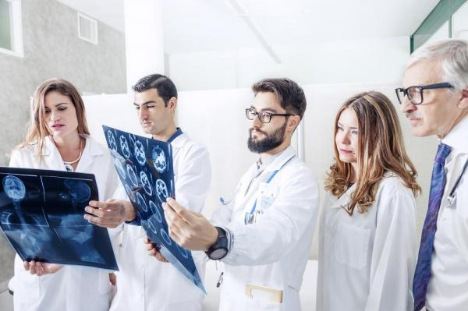
PROBLEM 1 – Doctors surprised during surgery
Notes:
Medical professionals undergo high amount of training but a number of times prognosis/using traditional approach still leads to surprises during the actual surgery.
Also teaching to from CT/MRI scans doesn’t give onour application/solutions would help them have a higher accuracy prognosis

Slide 4
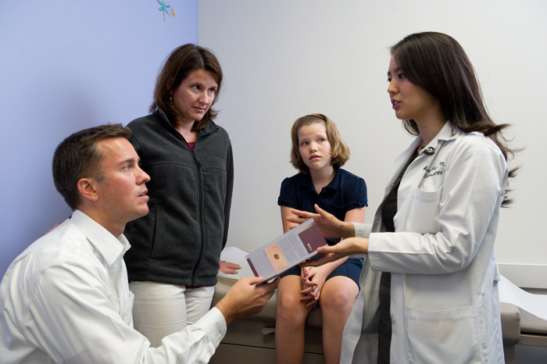

PROBLEM 2 – Patient concerns about surgery

Slide 5
Existing SOLUTIONS
Non VR/AR
2D/3D – CT/MRI scans
EEG
VR based
Surgical Theater - UCLA Neurosurgery
VR Games for Therapy

Slide 6
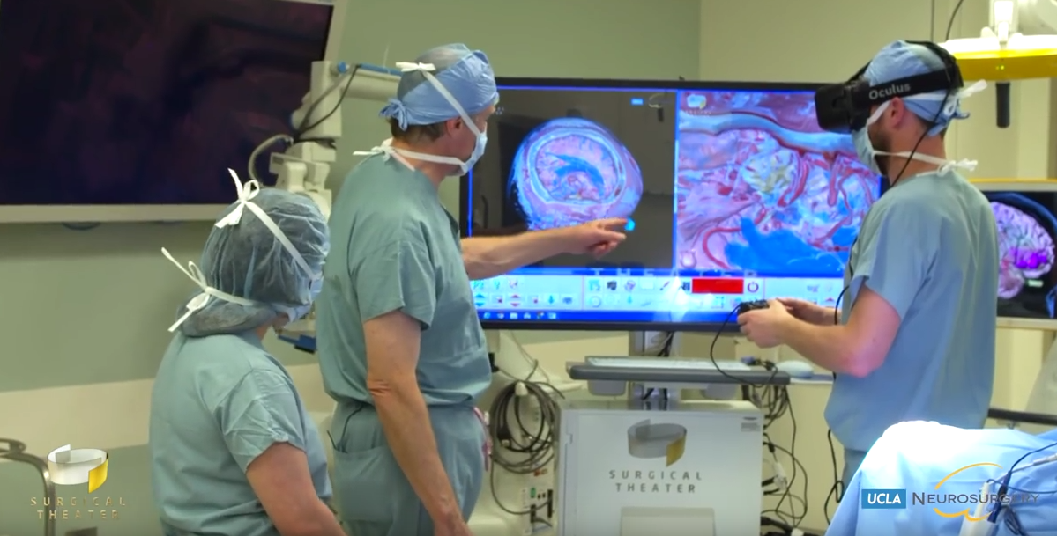
Surgical THEATER– Doctors Diagnosis

Slide 7
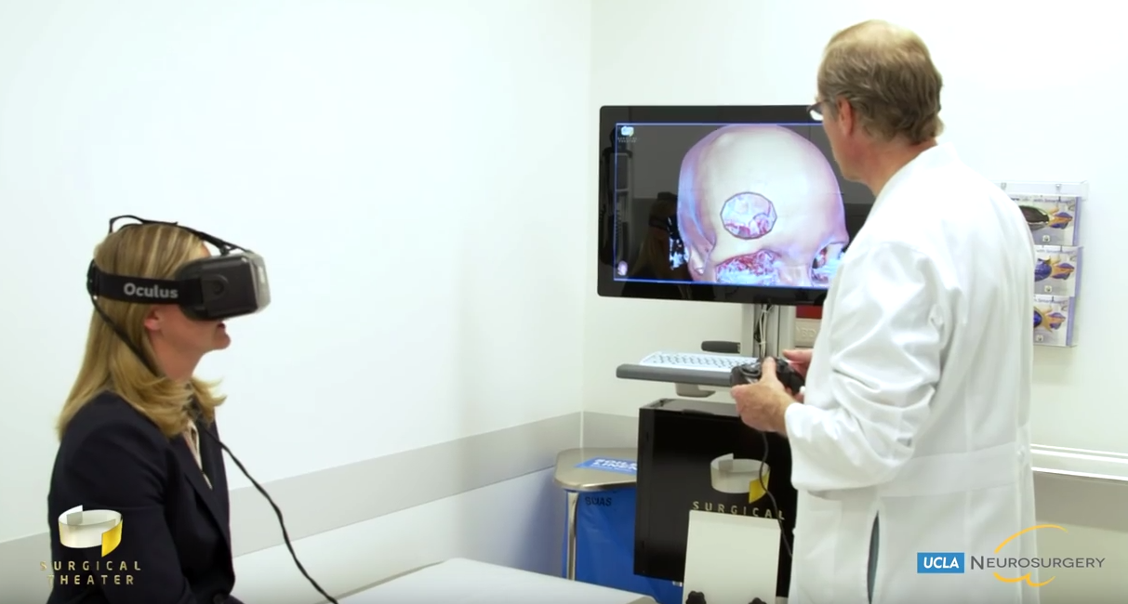
Surgical THEATER– Patient Consultation

Slide 8
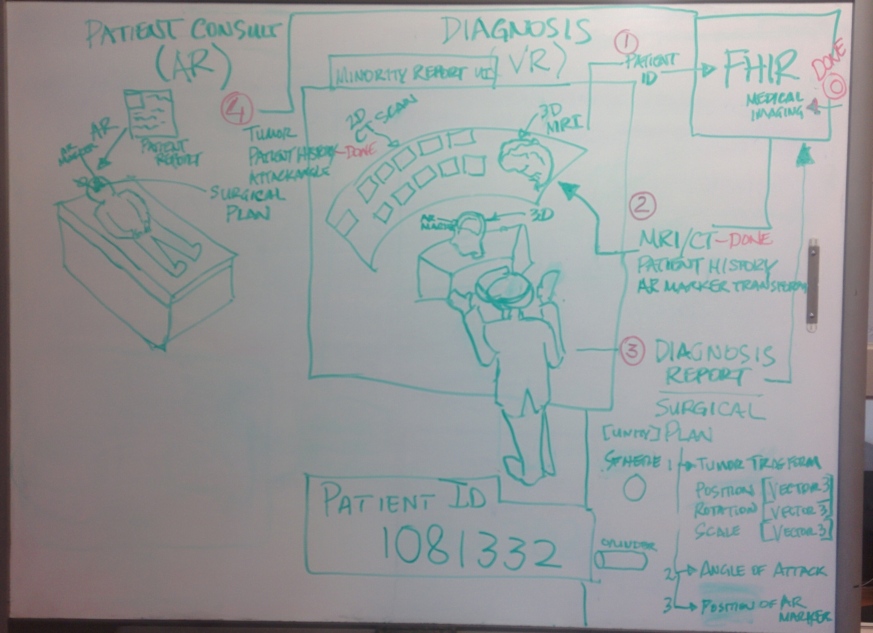

Slide 9

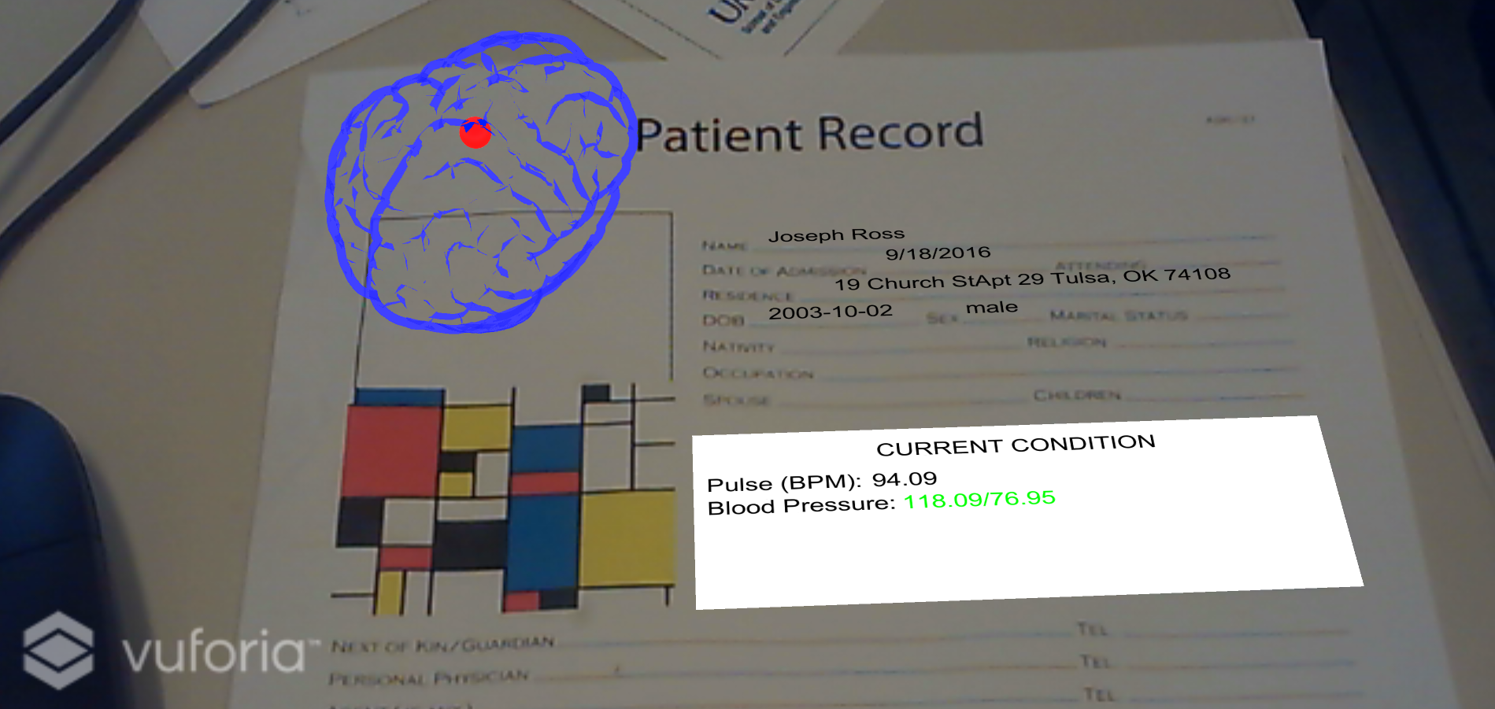
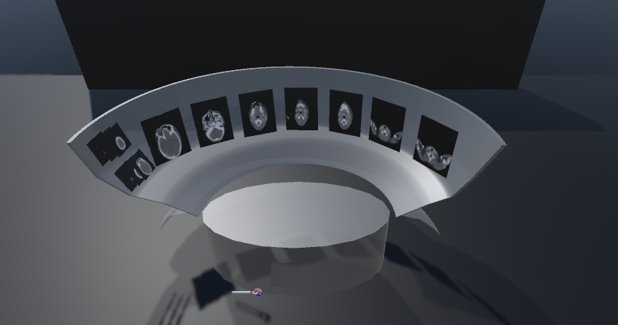
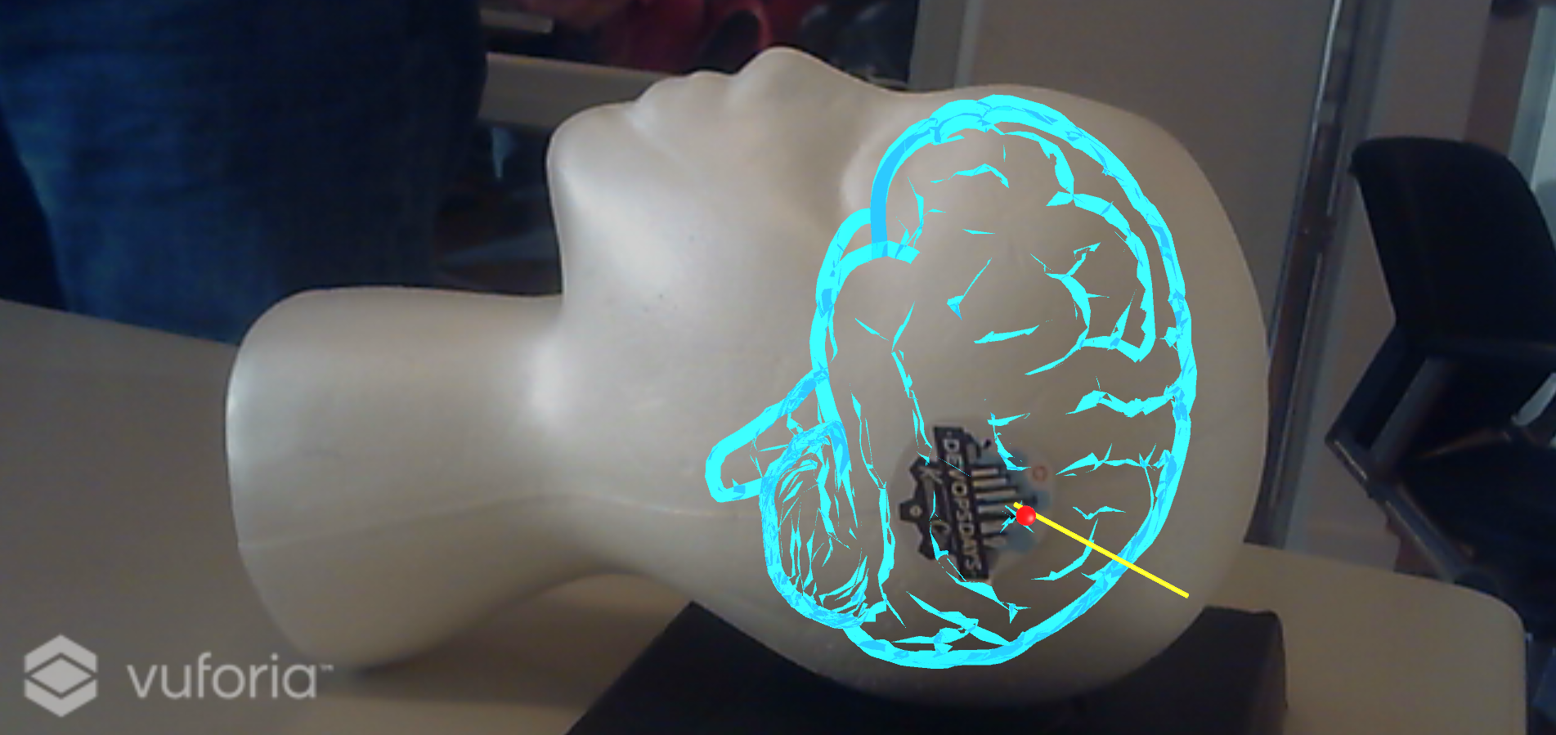
Patient Info,
Diagnosis report
Surgical Plan
Patient ID
AR
VR
CT Scans, Patient Info
Diagnosis Report & Surgical Plan
OR – Surgical Plan

Slide 10
Use of
URL | Description
https://fhir-open-api-dstu2.smarthealthit.org/DiagnosticReport | Image Storage
https://fhir-open-api-dstu2.smarthealthit.org/DiagnosticReport?patient=1081332 | Images back to VR environment
https://fhir-open-api-dstu2.smarthealthit.org/Observation | Tumor Location and Surgical Plan
https://fhir-open-api-dstu2.smarthealthit.org/Patient/1081332 | Patient Information
https://fhir-open-api-dstu2.smarthealthit.org/Observation?patient=1081332 | Get the tumor location and surgical plan

Slide 11
DEMONSTRATION

Slide 12
Future of
Immediate would be to extend it MRI scans and make it visually rich with color images
Extend diagnosis VR to medical/surgical training
Some other Mixed reality application
Treatment for PTSD
Rehabilitation
Exposure Therapy

Slide 13
Summary
MediMR – a Mixed Reality application can provide some innovative tools for
Doctors – for better diagnosis
Patients – to better understand problem
Just the beginning, Mixed Reality can be used in number of medical applications and can be a real game changer

Slide 14
Thank You
Techweek and Cerner Team
Think Big
DSI – providing awesome support
Everyone at this hackathon who made this a fun experience

Slide 15
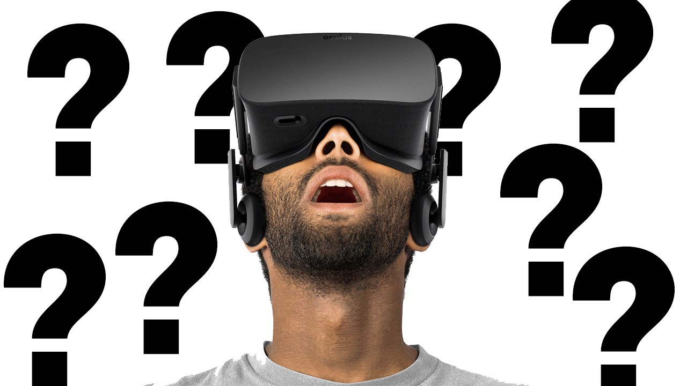

Slide 16
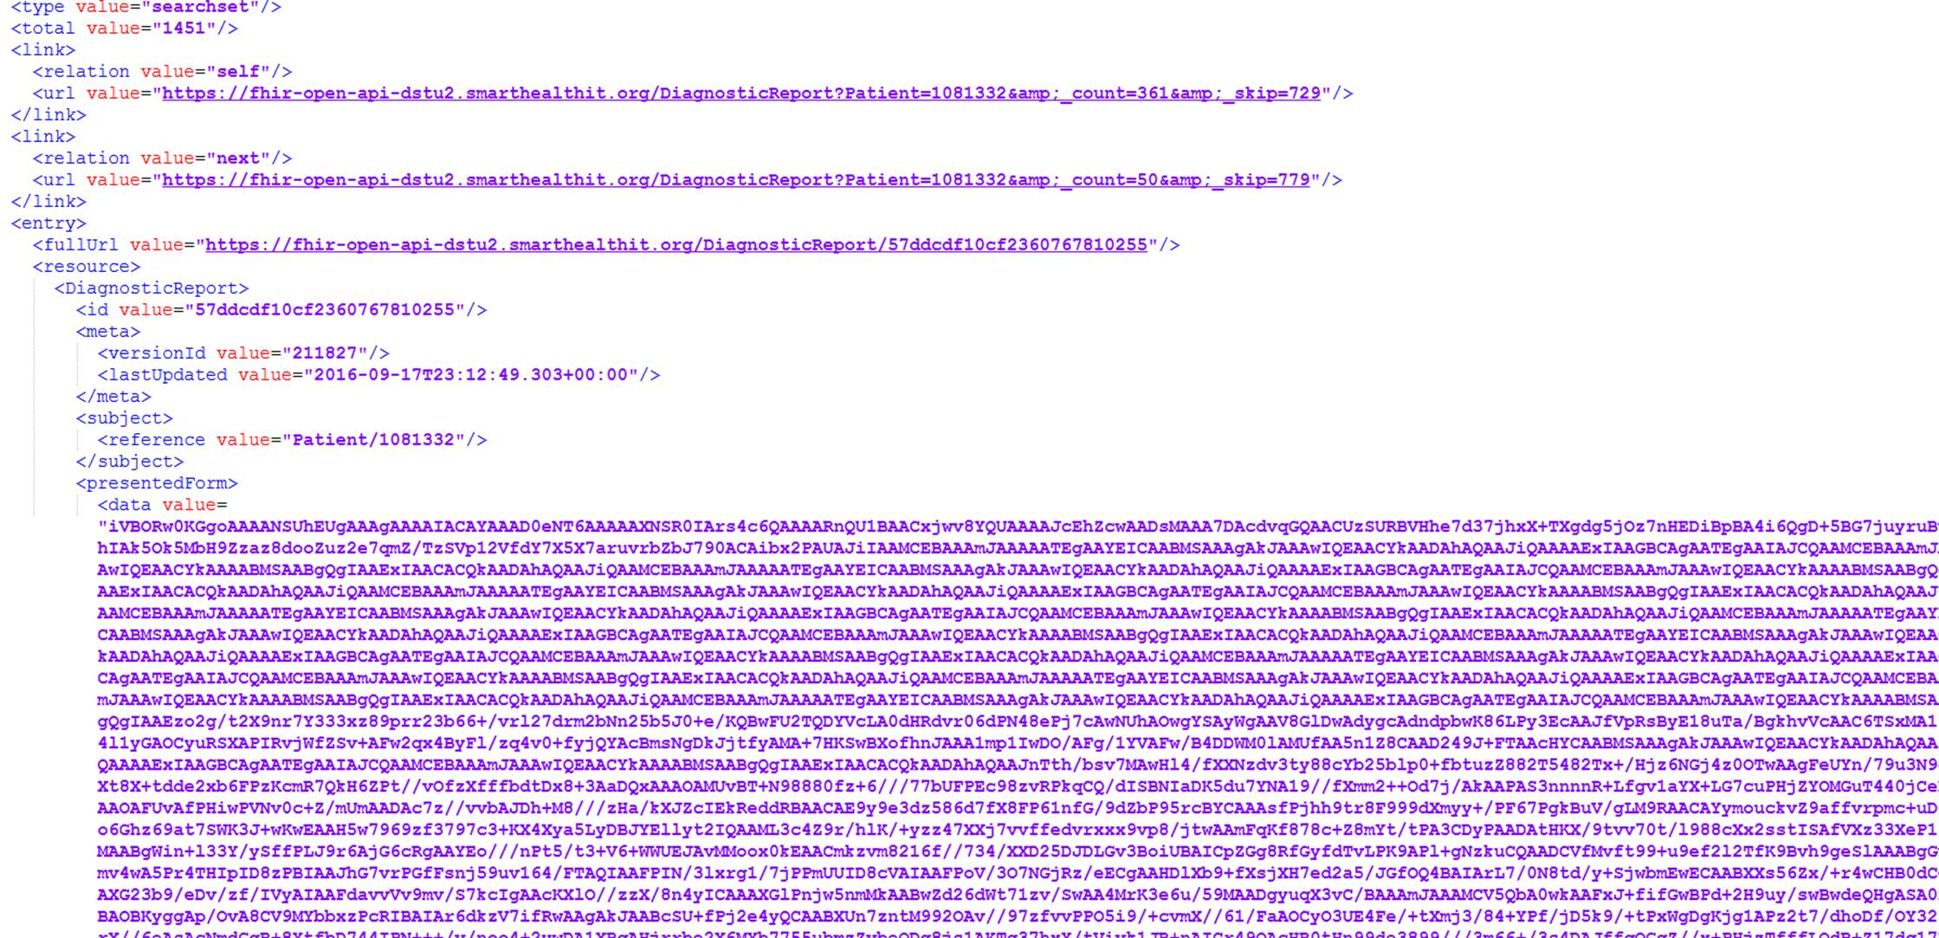
Sample image data from FiHR

Slide 17
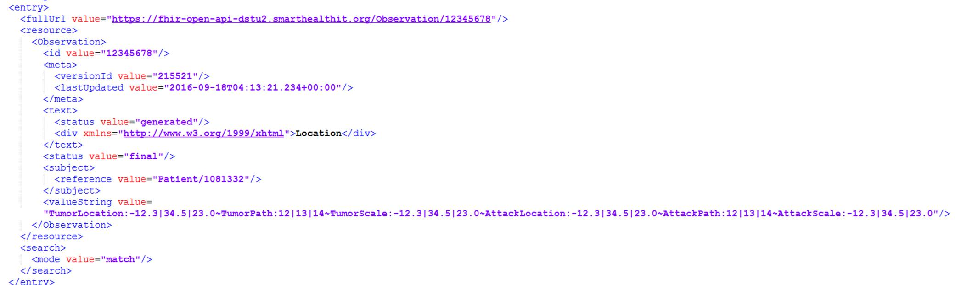
Image location from FiHR

